Slide 1
Riverview IB
Class of 2026
University Admission and Selection

Slide 2
The University Scene
20.3 million Americans enrolled in fall of 2023.
62% graduate with a degree within a six year period
41% graduate with a degree within a four year period (2020-2021)

Slide 3
IB Students and College Success
2018 Study of IB Students and University
The 4 year graduation rate for DP diploma earners was 84% compared to 41% nationally
IB students earned higher GPAs and graduated at higher rates than a matched comparison group (Across all family income levels)
Performance in the DP was the strongest predictor of college GPA
The average acceptance rate of IB students into university/college is 22% higher than the average acceptance rate of the population.

Slide 4
Trends in admissions
The total number of high school graduates increased from 2.7 million in 1988 to an estimated 3.4 million in 2023.
The result: More applications than ever are being submitted to colleges and universities

Slide 5
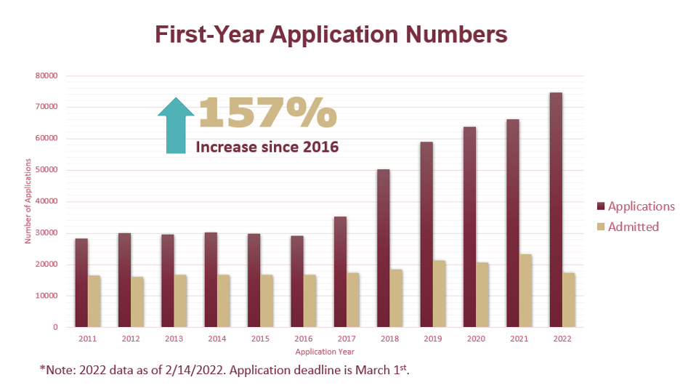
Florida Universities: Admission Impact
FSU

Slide 6
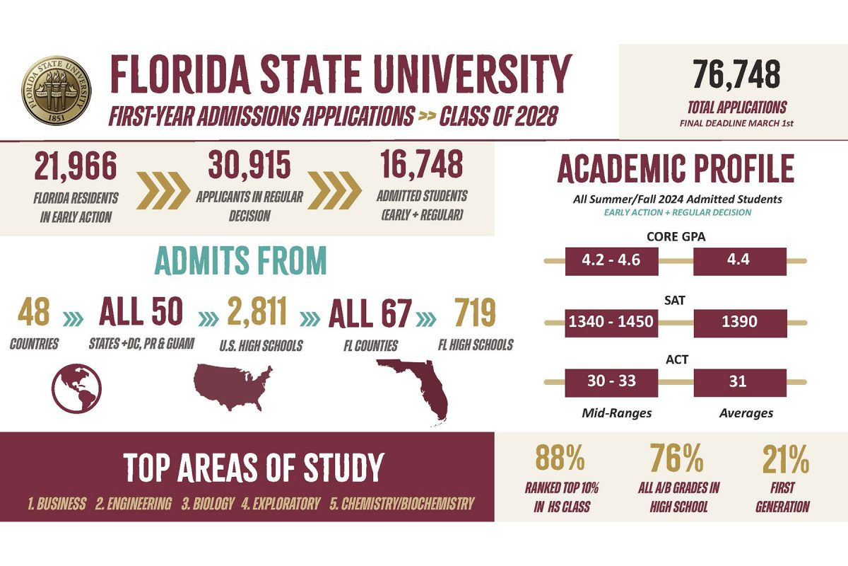

Slide 7
Impact: University of Florida
Applicant Pool
  To date, we have received more than 65,000 total applications, an increase of over 20% from this time last year, and more than double the total number of applications we received in 2016. We will be releasing nearly 53,000 decisions tonight.
  As in the past, the great majority of applicants showed the potential for success at UF, and many more were recommended for admission than we have space to admit. We made some very difficult decisions and realize there will be both excitement and disappointment when students view decisions.
  Admissions offers are being made to just under 15,000 students to start on campus in the Summer B or Fall term. Admitted students had the following middle 50% ranges:
    GPA: 4.5 – 4.7 (weighted recalculation)
    SAT: 1360 – 1500
    ACT: 30 – 34

Slide 8
Beyond this GPA calculation, UF evaluates:
The strength of the curriculum the student has taken based on the offerings available to the student as well as how the student has progressed academically over time.
SAT, ACT or Classic Learning Test (CLT) scores.
Extracurricular Activities: Consistent involvement throughout high school that demonstrates a student's interests and passions, as well as how applicants contributed to their school, community and/or family.
The quality of thought in the admission essay.
Personal Background and Experiences: We search for students who show the potential and desire to succeed in a rigorous academic environment. They will be UF's future community of learners, leaders and thinkers.
No one single factor determines an admissions decision.

Slide 9
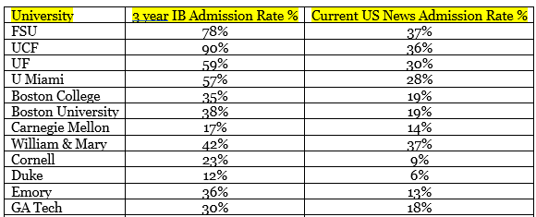
IB Enrollment Stats 2020-2022

Slide 10
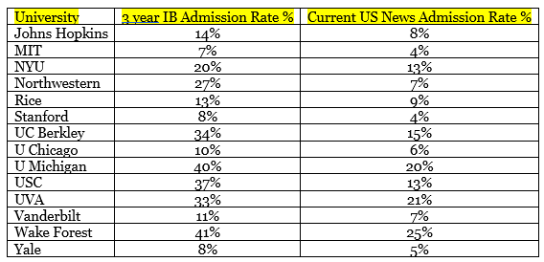
IB Enrollment Stats 2020-2022

Slide 11
Post-Covid-19 Trends
1. Virtual campus tours are more popular than ever
2. Follow your schools on Social Media – Twitter – Instagram
3. Increase in Early Decision numbers – colleges want to fill their numbers

Slide 12
University Admissions Officers….
(What we look for)
1. Academic strength of curriculum
2. Trend of Performance (GPA – Meaningful senior year)
3. Programs with external validation (IB assessment process)
4. Research and writing skills
5. Accepts educational challenges
6. Critical thinking skills
7. Interview skills
8. Extracurricular involvement
9. Recommendations
10. Maturity and responsibility

Slide 13
College applications: What is actually being evaluated?
Academic preparedness/course rigor and relevant grades. Colleges recalculate GPA.
Standardized Testing
Extracurricular engagement “LEADERSHIP”
Personal Qualities: Seen in recommendations, essays
Institutional priorities

Slide 14
University Admissions Office Role
Manage enrollment
In some cases, manage enrollment so as to meeting target tuition revenue for the University.
Balance institutional priorities for enrollment: “The equitable distribution of unhappiness.”
Recruit, select and yield a qualified, talented and diverse group of students for the entering class.
Serves as the public face of the University

Slide 15
Key elements of a successful college strategy
Apply early
Submit QUALITY over QUANTITY
Keep it manageable (6-8 applications)
2-3 Safety schools
2-3 Good fits
2 Reach schools (NOT DREAM SCHOOLS)

Slide 16
The College “fit”…
Key variables to consider
Type of school | Curriculum
Quality of education | Size of the school
Location of the school | Admissions Requirements
Facilities | Campus life and security
Housing and resources | Cost

Slide 17
College variables…..the details
Type: College, university, community college, technical, professional, trade schools, public or private
Curriculum: What do I want to major in? Does the school offer the necessary courses? Do you want a range of potential majors and study programs? Does it have professional certifications that my major requires? Does it have special programs such as study abroad, internships, co-op availability?
Quality of Education: How accessible are the professors? Will professors or graduate students teach my courses? How involved do you want to be in research and learning outside of the classroom?

Slide 18
Size: Do I want to be on a large campus with many majors and lots to do? Do I
prefer a smaller schools where I know everyone? Do you prefer large lectures or
small classes with lots of student participation?
Location: Which part of the country would you like to experience? Do you want an
urban or a small town setting? Climate? Do you want to stay close to home….or as
FAR AWAY AS POSSIBLE?
Admission requirements: What does the school require for admission? What
does the school look for in prospective students? What are your chances of being
accepted?
Facilities: What would I like to see on or near your college campus? Are restaurants,
shops, health clubs, laundry, library, computer labs and research facilities important?
Transportation on and around campus?

Slide 19
Campus life: How is life outside the classroom? What special interest groups,
activities and fraternities/sororities do you want to be involve with? Athletics?
How are the sports facilities?
Campus security: What’s the local community like? How safe is the campus? How
safe are the surrounding neighborhoods?
Housing and resources: What is the quality of dorm life? Is housing guaranteed for
returning students? Are there off campus housing opportunities? Meal plans
available? Retention and graduation rates? Percentage of students who stay for
four years and graduate? What sort of career planning or job placement services
are available?
Cost: What will it cost? What financial aid options are offered? How much can
you afford?

Slide 20
Look for College/University IB Landing Pages
https://www.ncf.edu/admissions/first-year-students/ib/
  IB Specific Programming
  IB Credit Policy
  IB Alumni Voices

Slide 21


Slide 22
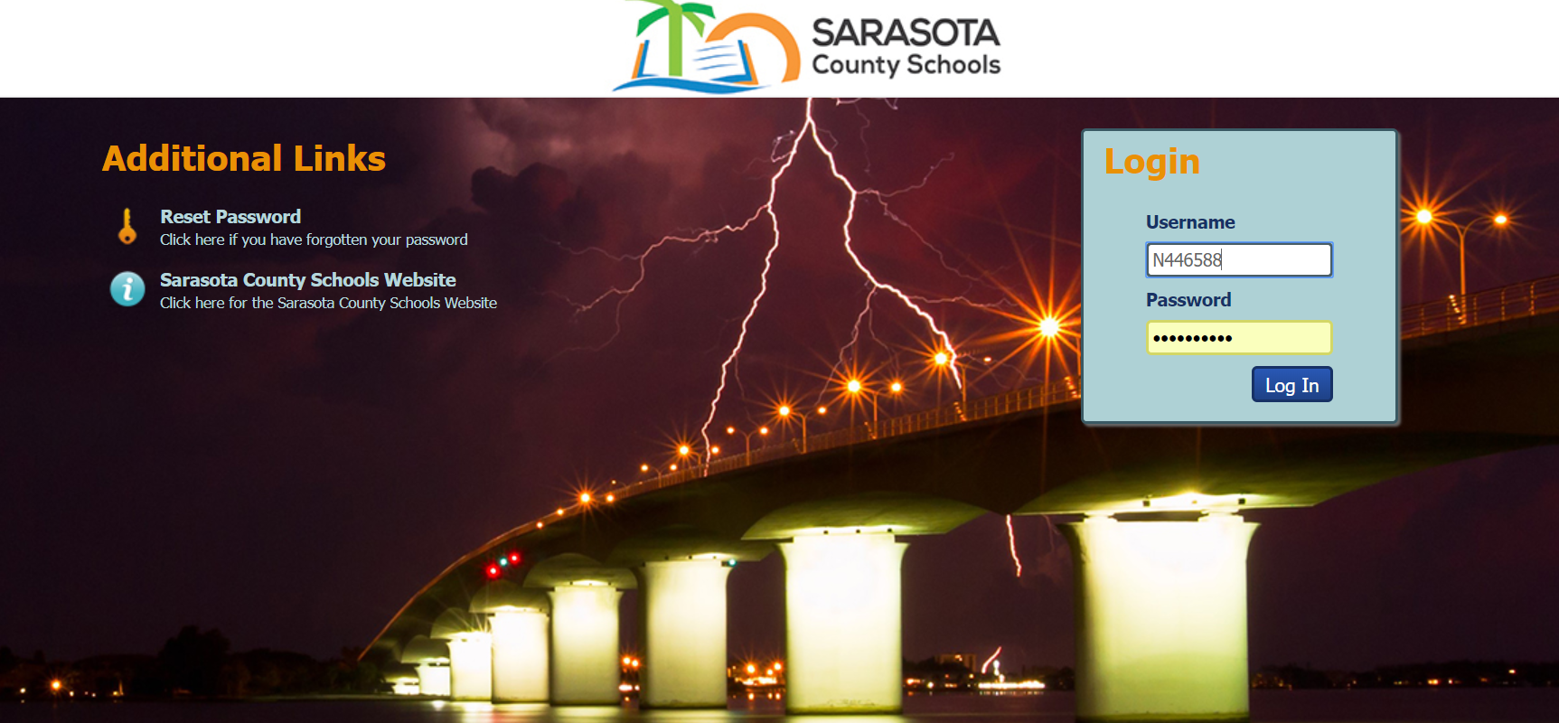

Slide 23
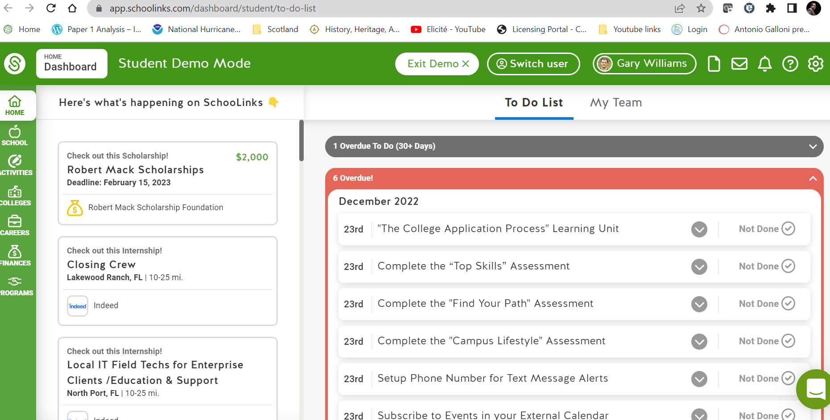
Schoolinks

Slide 24
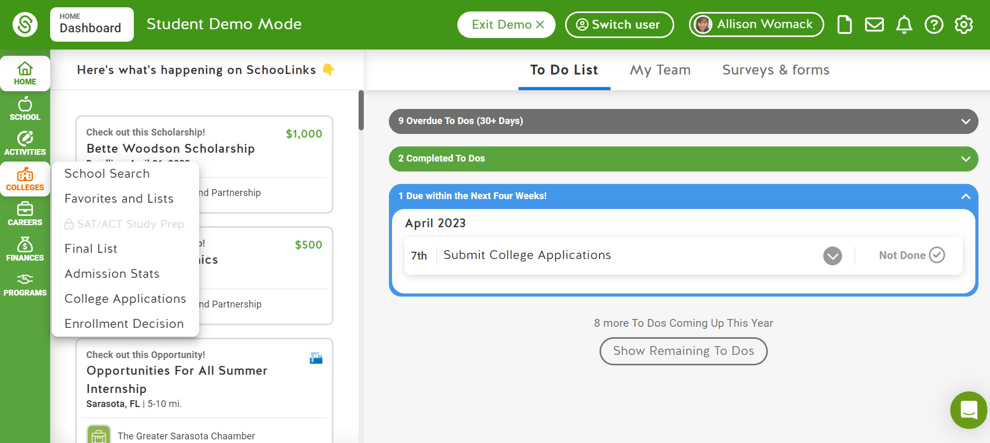

Slide 25
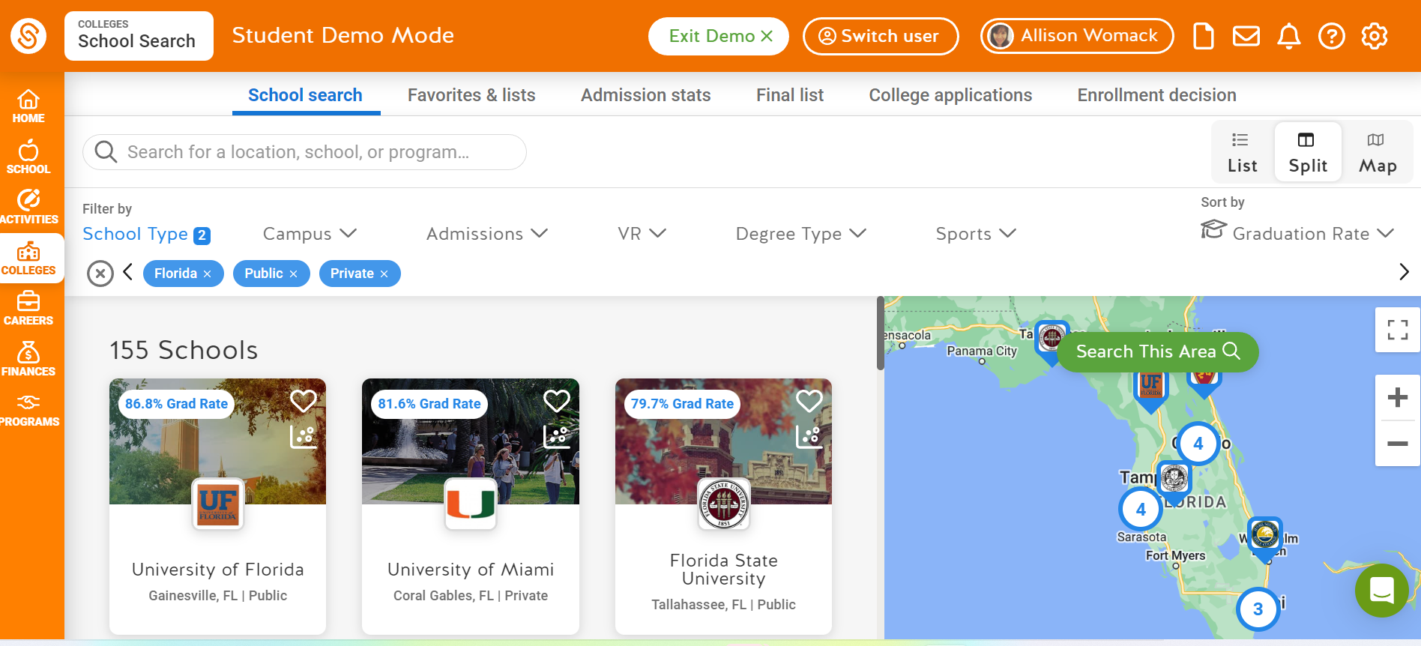

Slide 26
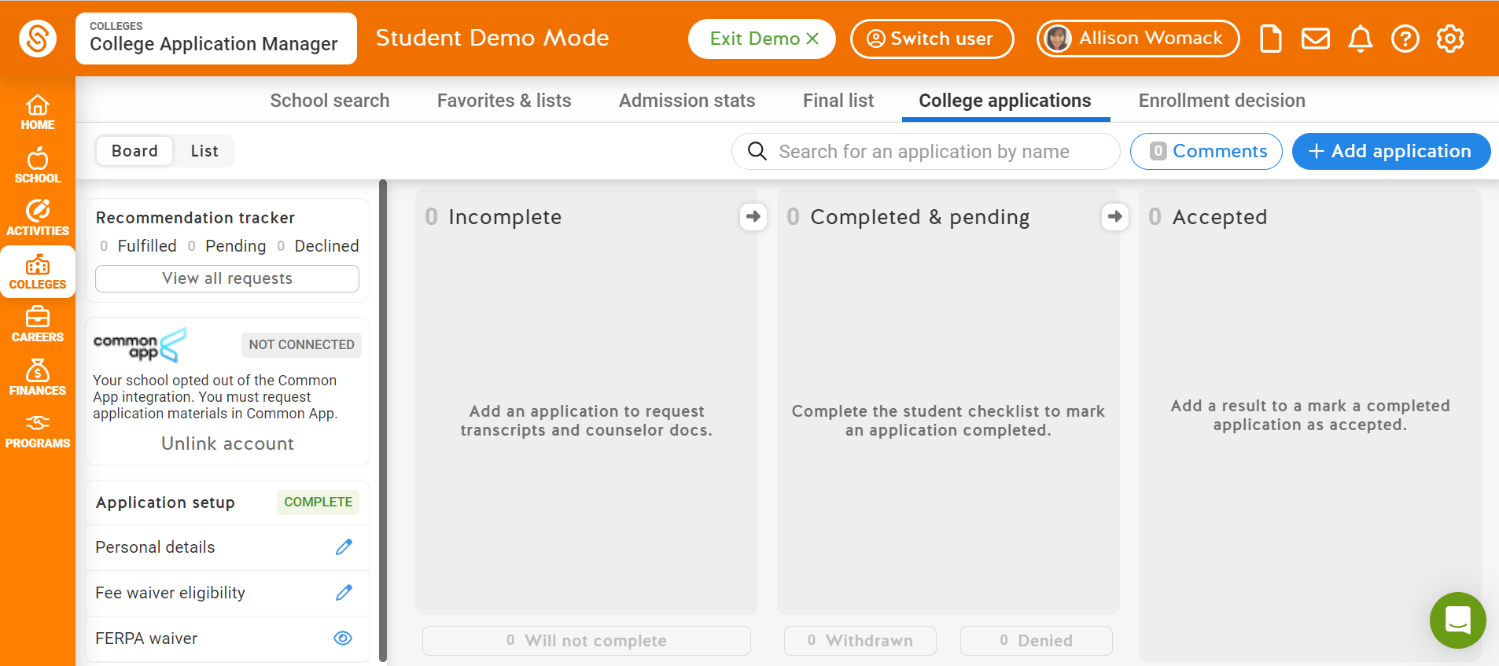

Slide 27
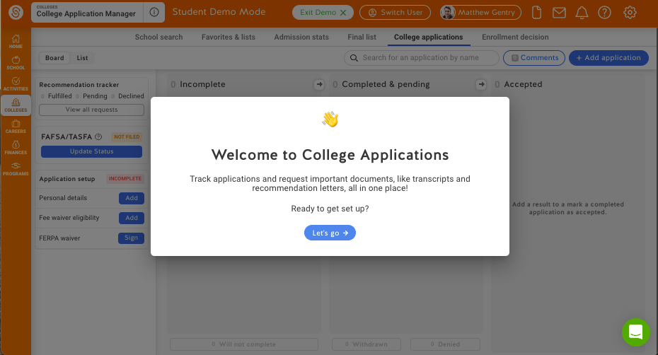
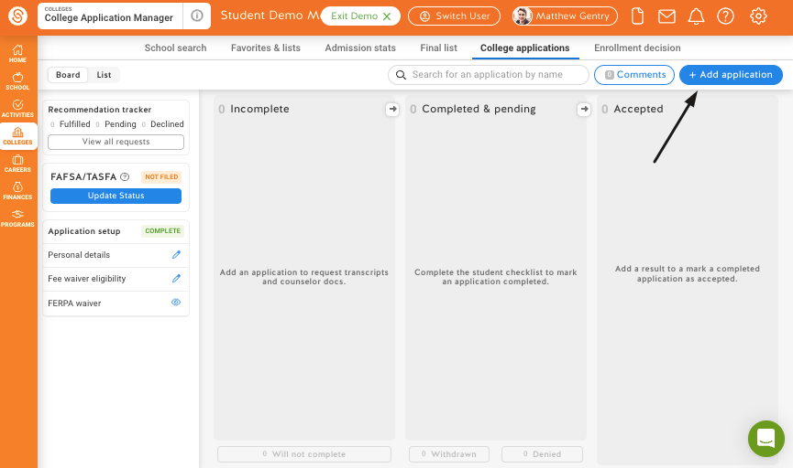
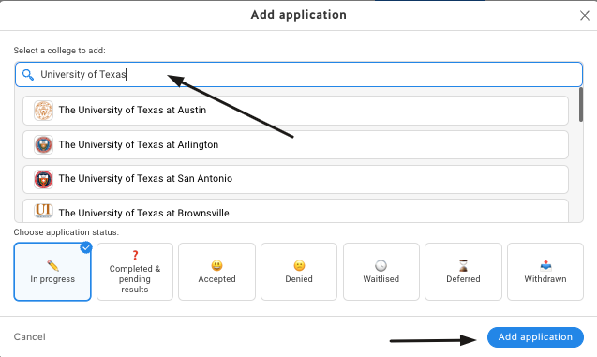
Getting Started
Navigate to the College Application Manager by clicking on
Colleges → College Applications
1.
Complete the Application Set Up: -Personal Details
-Fee Waiver Eligibility
-FERPA Waiver
2.
Start tracking your first application by clicking +Add Application.
Search for the school and then click Add Application
3.
Tip: If you have schools added to your Final List in SchooLinks you can select from this list to start an application

Slide 28
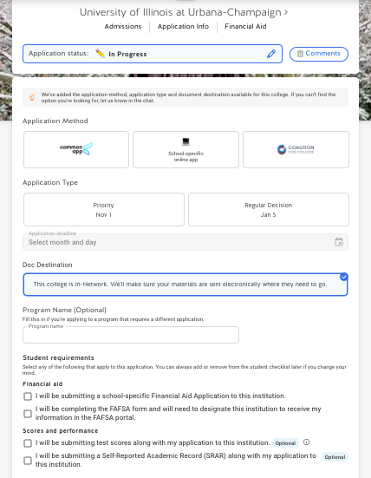
Application Details
After adding an application, fill in your application details.
Select an Application Method and Application Type/Deadline.
Select any optional student requirements needed. Required materials will be automatically selected.
Save your application.
1.
2.
3.
4.
Note: Application details can be edited at any time. Once you click Save, this will automatically request required counselor documents for the application

Slide 29
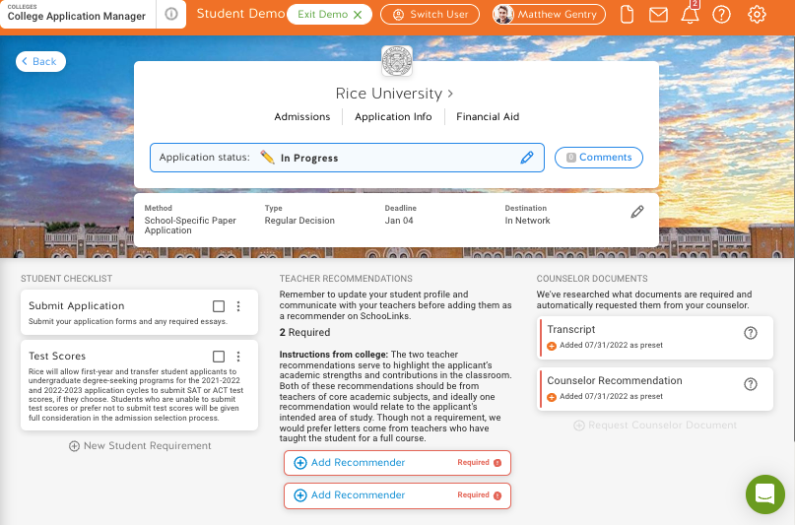
Application Requirements
Student Checklist:
Check the box once tasks are complete.
Teacher Recommendations:
Request recommendations for the total # listed.
Counselor Documents:
Any required documents will be automatically requested.
Reach out to your counselor if you need additional documents sent.

Slide 30
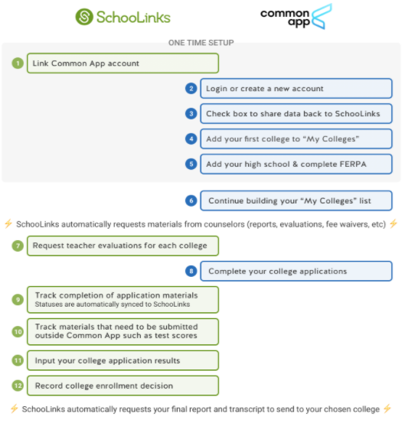
Connecting with
Common App
First, link your Common App account by clicking the button on the College Applications page. You can also watch this video to see the process.
Login or create a new Common App account.
Check the box to share data back to SchooLinks.
Add your first college to “My Colleges” and complete the FERPA waiver.
Use these steps to keep track of what is completed on SchooLinks and Common App.
1.
2.
3.
4.
5.

Slide 31
Scholarships
Florida bright futures: 100% with full IB Diploma and completion of 100 Service Hours: 75% completion of DP curriculum with minimum SAT/ACT score
Maximum number of transfer credits
Honors colleges….advanced study programs
Merit/need based
University based scholarships
Community based scholarships
Work-related scholarships

Slide 32
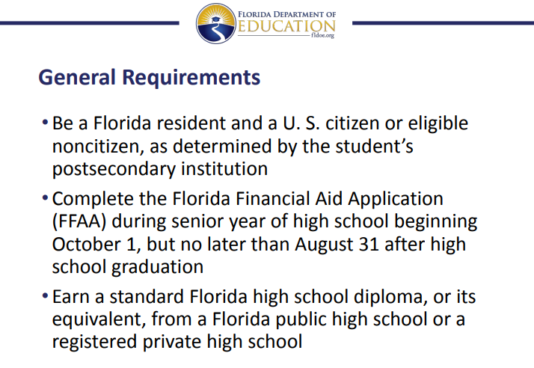

Slide 33
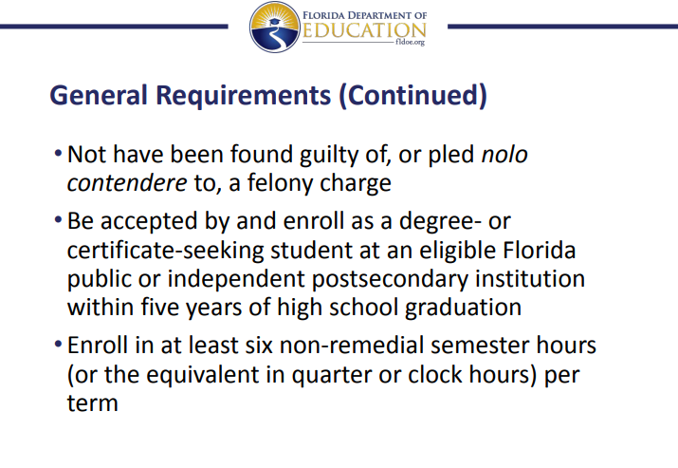

Slide 34
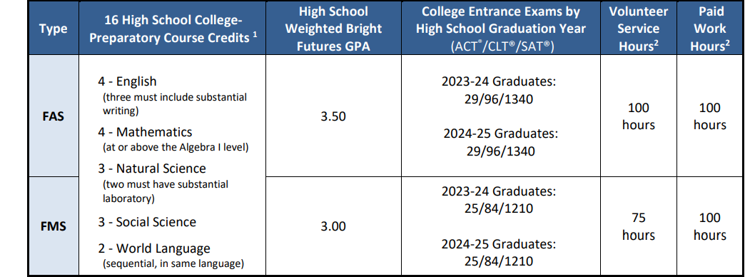

Slide 35
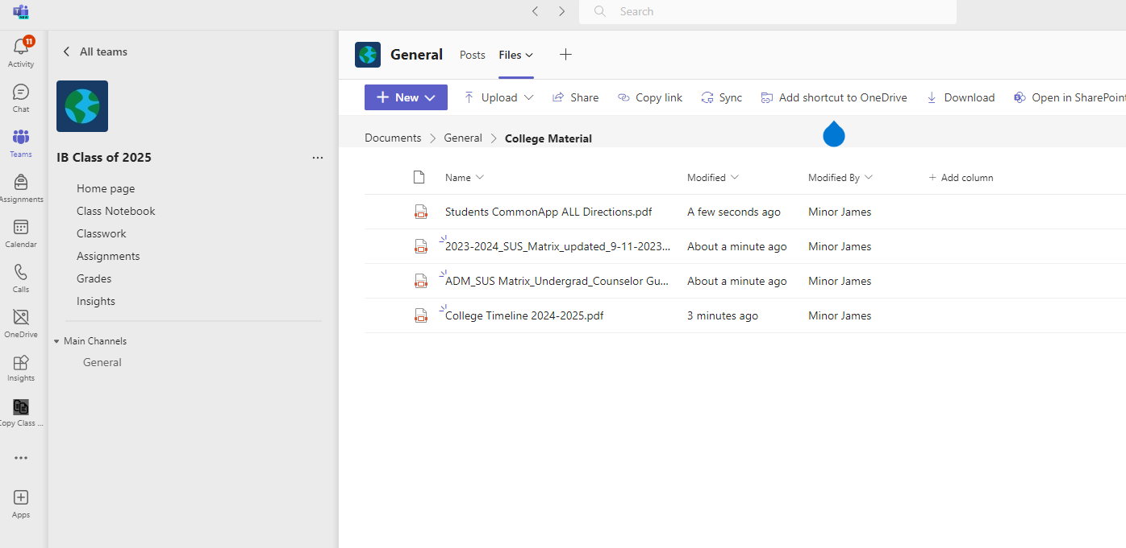

Slide 36
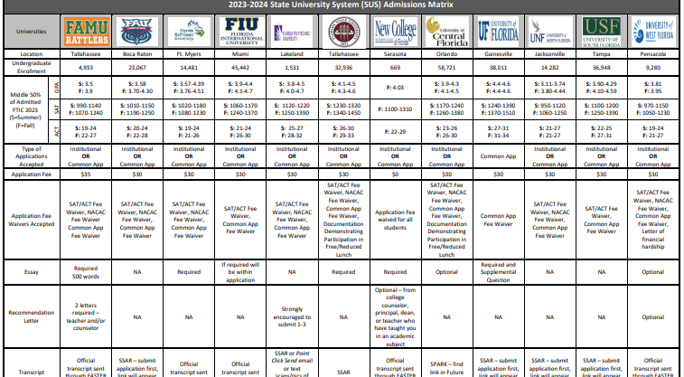

Slide 37
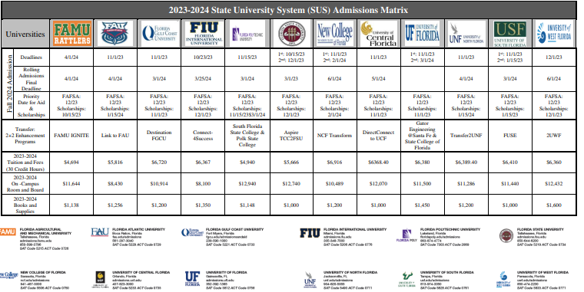

Slide 38
Current trends in college admissions
Sticker price is just the sticker price!
State universities are being underfunded
60%-70% Riverview IB stay in state
Not having a manageable number of applications is counter-productive
Riverview IB is “sought-after”
Safety/solid universities will compete $$ against each other for IB
Early action is popular
Early decision is viable
Showing interest is always a plus: College reps, tours, etc….

Slide 39
And now….tips for parents
Do:
Listen with an open mind;
Accept the role change from your child shifting from dependence to independence;
Be involved and interested in the college selection process;
Be realistic about your expectations;
Be patient about your child’s follow-through with the myriad tasks surrounding college admissions
Be in tune to your child’s emotions. There may be a message behind the procrastination
Use the Riverview IB team as a resource! We are invested in your children.
Have a sense of humor – brace yourself for some weird moments

Slide 40
Don’t:
Live vicariously through your son or daughter. Let them follow their dreams, their path to their destiny;
Indulge in “cocktail party college talk” – making college selection decisions for your child based on the basis of others’ positive or negative experiences;
Assume responsibility for aspect of the college search and admissions process that are the responsibility of your child;
Expect your child to follow the family alumni track. It may not be a realistic option based on the ever-changing college market.
Please help us by not accepting or excusing school absences, tardies and acting out. There is a strong correlation between junior/senior year performance and college performance. The trend of performance matters!

