Slide 1

Coffee with the College Counselors

Slide 2


Student Success Center
→Francisca Ruiz-Tagle
  College Career Advisor
  Francisca.ruiz-tagle@sarasotacountyschools.net
  Extension-64181
  →Sarah Hu
  College Career Advisor
  Sarah.hu@sarasotacountyschools.net
  Extension- 64182
Available for student meetings:
All lunches
Before & after school
During class with teacher permission

Slide 3
IB Guidance Counselors
Katherine Borriello | IBCP | 5-307A |  | Ext 64232
Carla Harding | IBDP A-L | 5-331C |  | Ext 64243
Rose Beach | IBDP M-Z | 5-331A |  | Ext 64244

Slide 4
Overview: Completing College Application Process
Connect Common App & Schoolinks. This allows guidance counselors to send transcripts & counselor rec. Request teacher recs here (if required)
Order official test score reports for schools that require.
Complete & submit Common App by Early Action deadline. Submit schools one at a time.
Each school emails invitation to their school’s application portal.
Complete additional steps on school’s application portal by the Materials Deadline.
Complete & connect SSAR/SPARK. (Not required by FIU & FGCU)

Slide 5
Out Of State Schools &
Schools Not On Common App
Communicate regularly with guidance counselor & Dr. Minor & teacher recommenders
Mind your deadlines & communicate them!
Keep checking School Portals to ensure all materials are submitted
STUDENTS are responsible to manage this process!

Slide 6
FL Schools Requiring Official Test Score Reports
FL Schools Self-report Test Scores on
SCHOOL PORTAL
FAMU
FGCU
FIU
UCF
UNF
USF
UWF
FAU
FL Polytech
FSU
NCF
UF
KNOW YOUR Materials Deadlines!!
Private & Out of state schools:
Check Admissions websites!

Slide 7
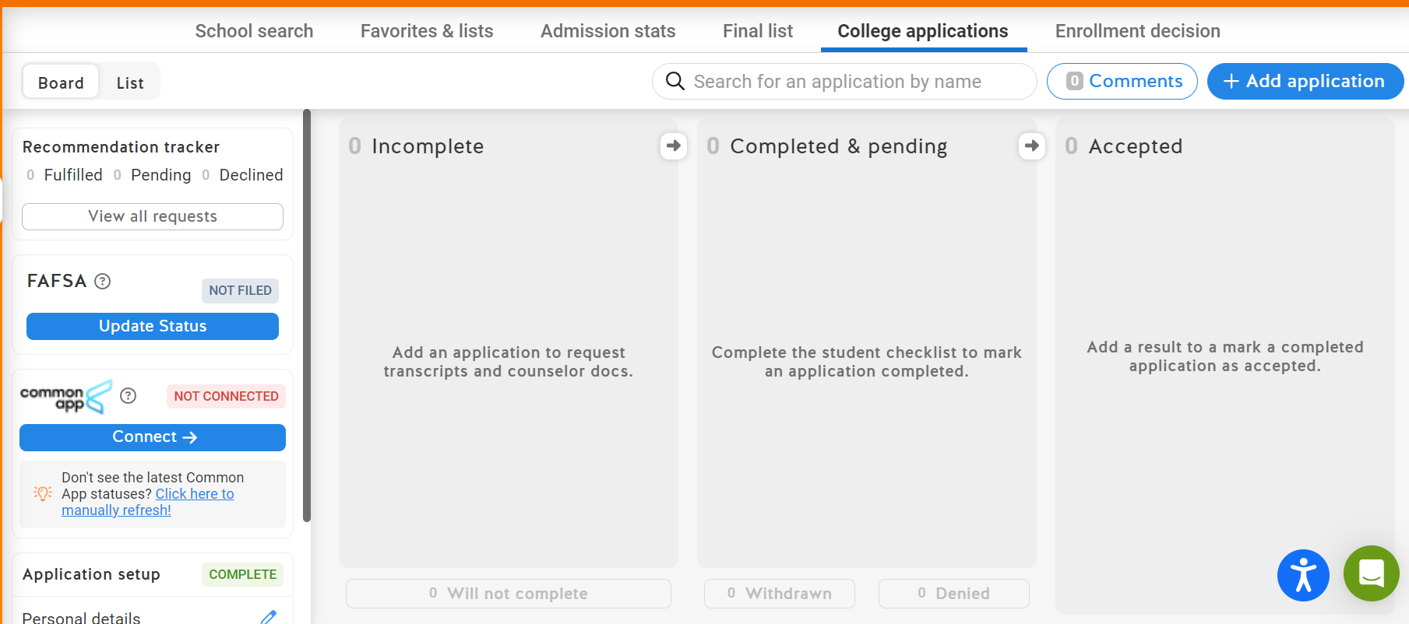
Transcripts for College Applications
CONNECT your Common App with Schoolinks
Schools will move from Incomplete to Completed & pending column once guidance counselors have sent transcripts & req’d documents

Slide 8
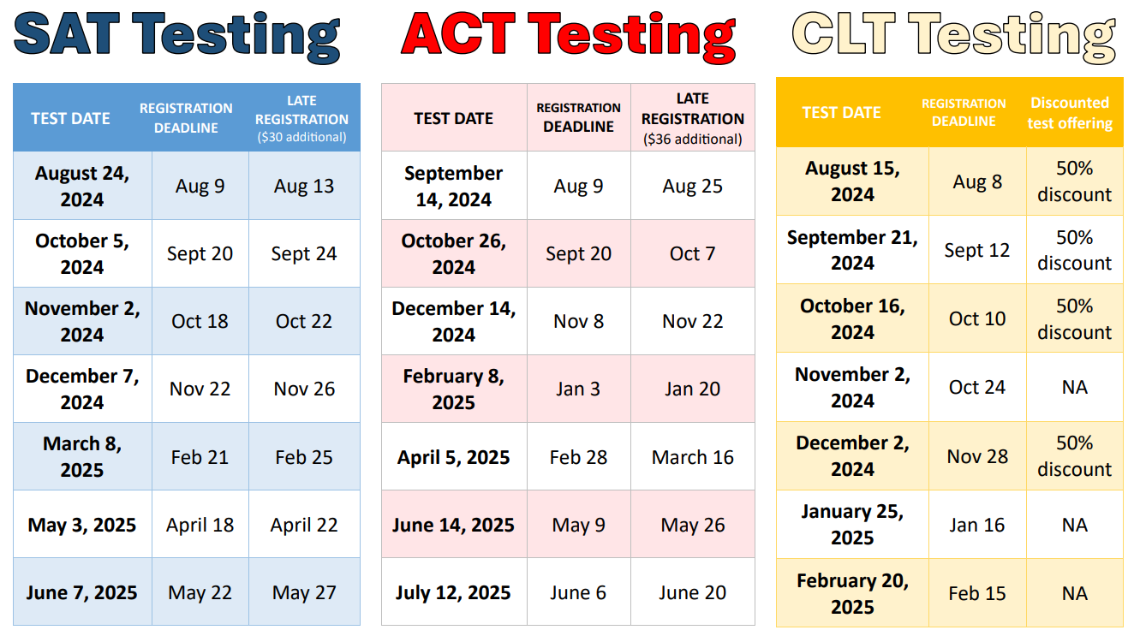

Slide 9


GuEsS wHo’S CoMiNg to RHS?
My SCS → Schoolinks → Events to register
FSU (Florida State University): September 26
Notre Dame: September 27
UF (University of Florida): September 30

Slide 10
Early Action, Priority, Rolling Admission
In the My Colleges tab: info about different deadlines
Early Action: FSU & UF give FL students an advantage to apply earlier than out of state students. Apply by this deadline to have your best chance!
Priority: To be considered for all scholarships
Rolling: The sooner you apply the sooner you'll get a decision
Early Decision: binding, not offered by any public univ in FL

Slide 11

Common App
Post It
Keep a running list of questions & where each question is located to bring into the SSC!
https://www.commonapp.org/
Common App tab: info sent to ALL SCHOOL, incl personal statement
My Colleges tab: info sent to individual schools, incl supplemental essays

Slide 12
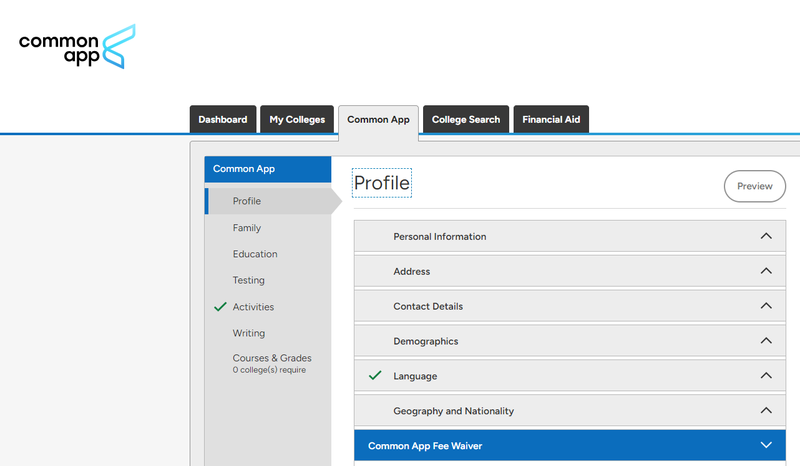
Common App: Profile
1
2
3
https://www.commonapp.org/
Dashboard:
Deadlines & requirements
2. My Colleges tab:
sent to individual schools
incl supplemental essays
3. Common App tab:
sent to ALL SCHOOLS
incl personal statement

Slide 13
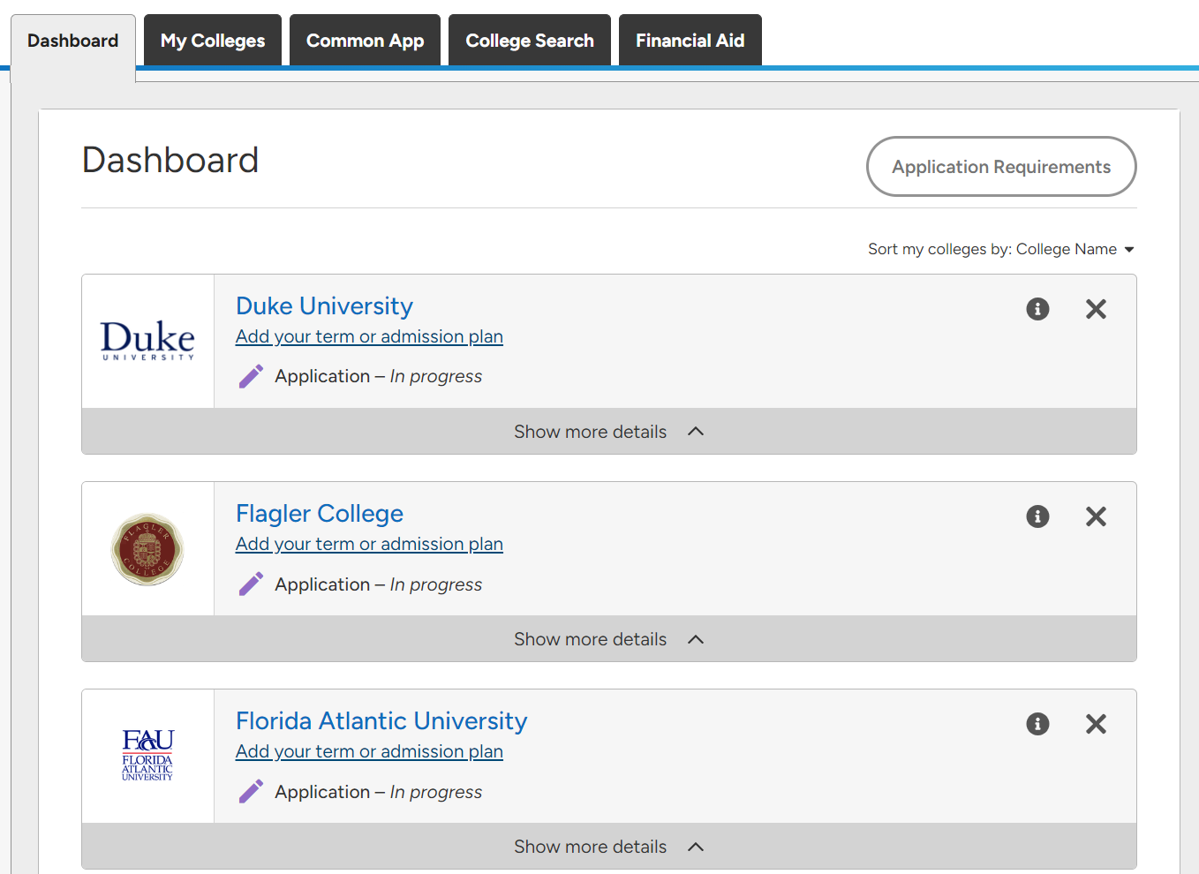
1
Love a good spreadsheet??!

Slide 14
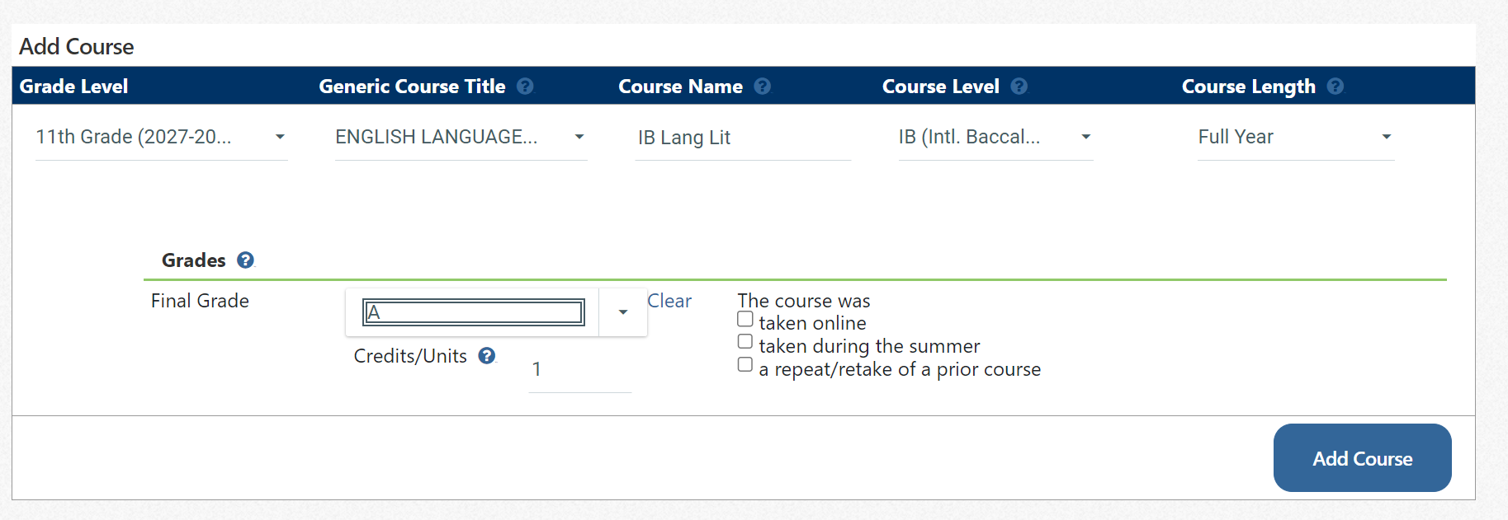
SSAR: Student Self-Reported Academic Record
Must be ACCURATE & COMPLETE!
Course name matches Transcript (Focus grades -> All Years & All Schools)
Time consuming, but no thinking needed
When you need a brain break, but still trying to be productive

Slide 15
School Selection Strategy
3 Reach (lower half or not within middle 50)
3 Targets (in upper half of middle 50)
3 $afeties (above middle 50) $$$
CONSIDER…
Mix of large & small schools: different evaluation processes
Sound strategy = multiple good options, even with surprises
Merit scholarships from $afeties: do your research!
ONLY applying to reach schools out of state? Likely to end up in FL

Slide 16
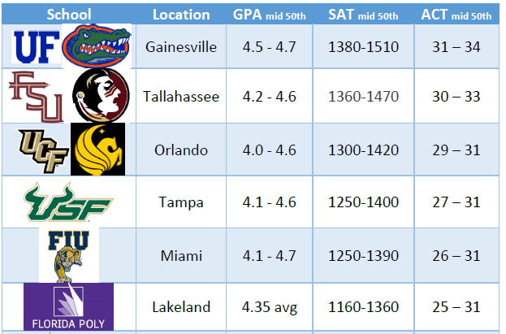

Slide 17
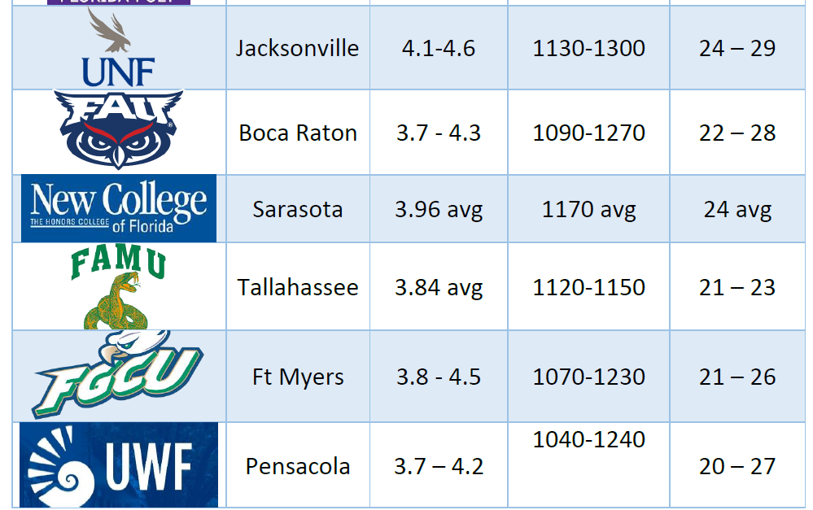

Slide 18
Deadlines To Submit Common App

Slide 19
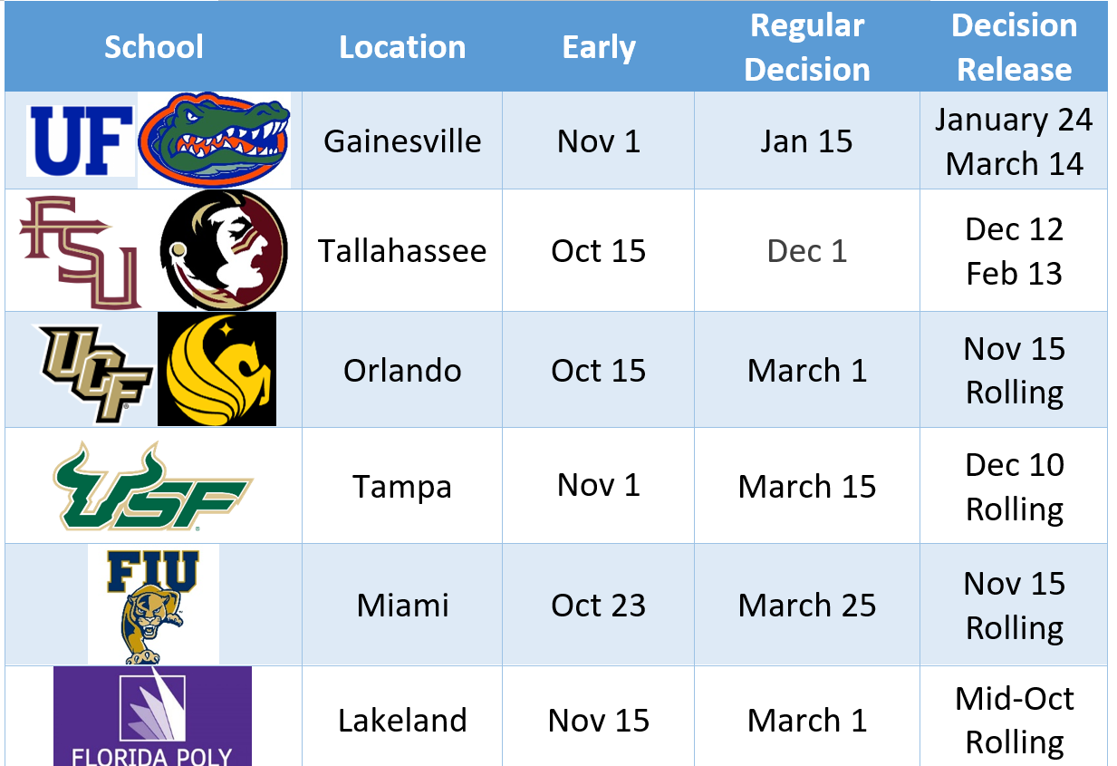

Slide 20
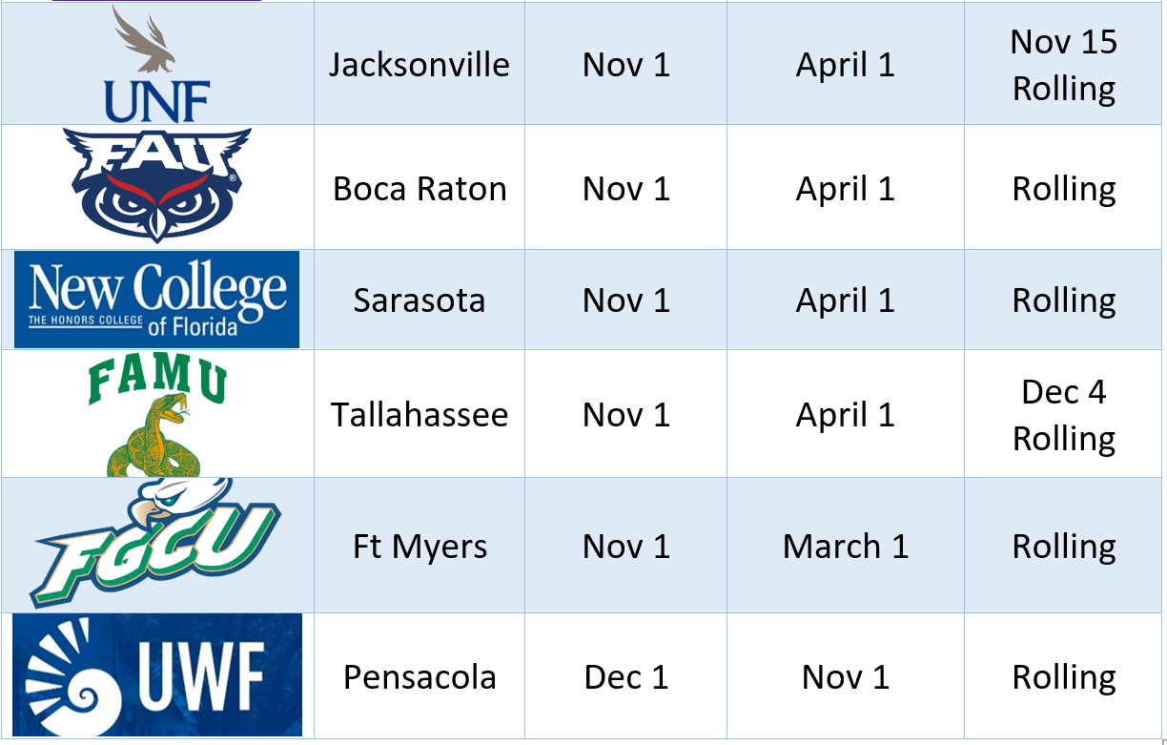

Slide 21
Financial Aid info

Slide 22
Financial Aid & Scholarships
Oct 1 Bright Futures Opens
Dec 1 FAFSA opens
Nov 21, 5-7pm: FAFSA FSA ID Night
Dec 10, 5-7pm FAFSA Workshop
Jan 23, 5-7pm FAFSA Workshop

Slide 23
Financial Aid vs. Merit Scholarships
Financial aid is provided based on the family’s financial circumstances. Every admitted student at an institution is eligible for financial aid on the same basis.
Merit scholarships are awarded based on test scores, GPA, or other qualifications. Not all students admitted to an institution will be eligible for merit scholarships, only the top candidates.
Students are more likely to qualify for merit scholarships at their safety schools, where they are the top candidates.

Slide 24
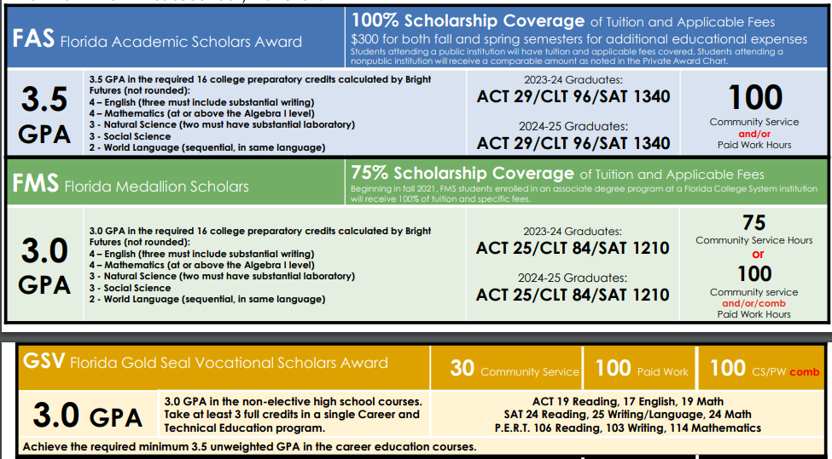
For Technical Certificate or Community College (AS)
SAT Reading/Writing 490 Math 480
PERT 106 Reading, 103 Writing, 114 Math

Slide 25

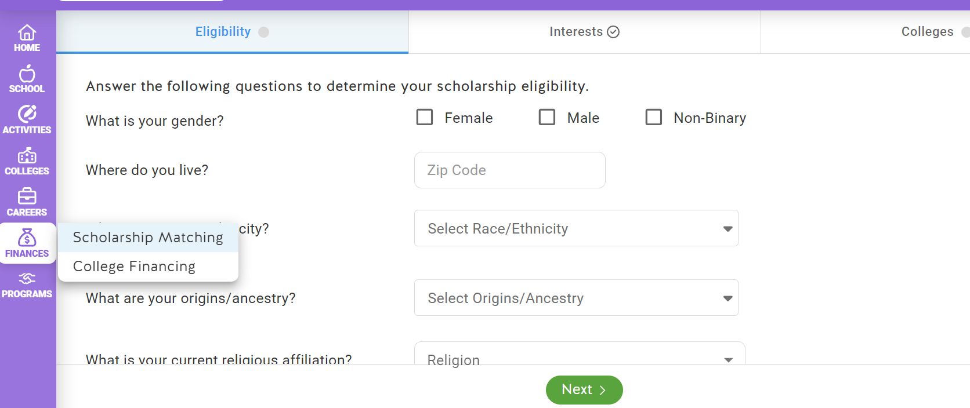
Scholarships
My SCS → Schoolinks → Finances

